Slide 1
MSIS 615 BUSINESS PROGRAMMING
GROUP - 14
Prakhar Shrivastava (02044010)
Sukumar Surasura (02018010)
Aasim Hussain (02073746)
Arpita Shrivas (02075452)

Slide 2
UNITED STATES USED CAR MARKET
The United States used car market is highly fragmented, with vendor type, fuel type, body type, and sales channel.
Consumers are more aware of the vehicle, its residual value, third-party margin, and other factors due to every detail easily available on website.
Buying a used car is a terrific method for a middle-class or learner driver to get a good vehicle for a low price and eventually go on the road without spending a bunch
As international students we were curious to explore the domination of used cars market, as back in India this is not a common practice which is why we chose CARGURUS.COM to explore the data around this area.

Slide 3
PROJECT OUTLINE
Used website cargurus.com as a target data source
Applied web crawling on the website
Fetched 923 rows and loaded to SQLite database
Performed data cleaning on the loaded data
Applied below data analysis methods to understand the market:
Regression
Visualization
Descriptive analysis
Provided insights on data majorly focusing on Price analysis

Slide 4
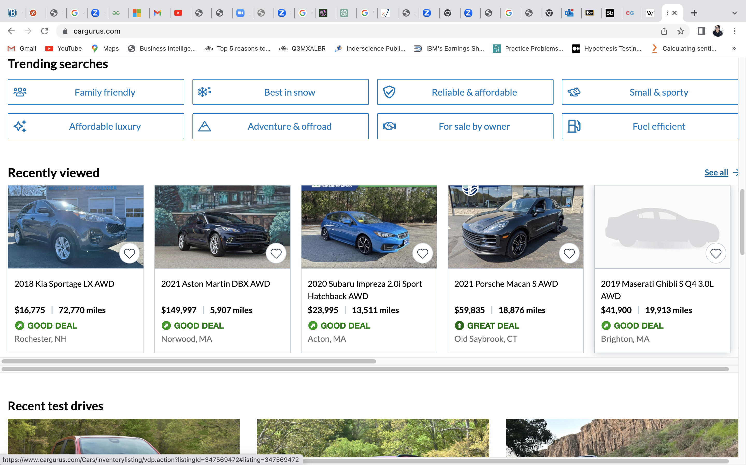
CARGURUS.COM
It is an automotive research and shopping website that assists users in comparing local listings for used and new cars, and contacting sellers
Uses algorithms to analyze and compare prices and features on cars for sale
Customers can search for specific cars in their local area and compare listings by price, features, and dealership reputation
Also provides discussion platform for car enthusiasts

Slide 5
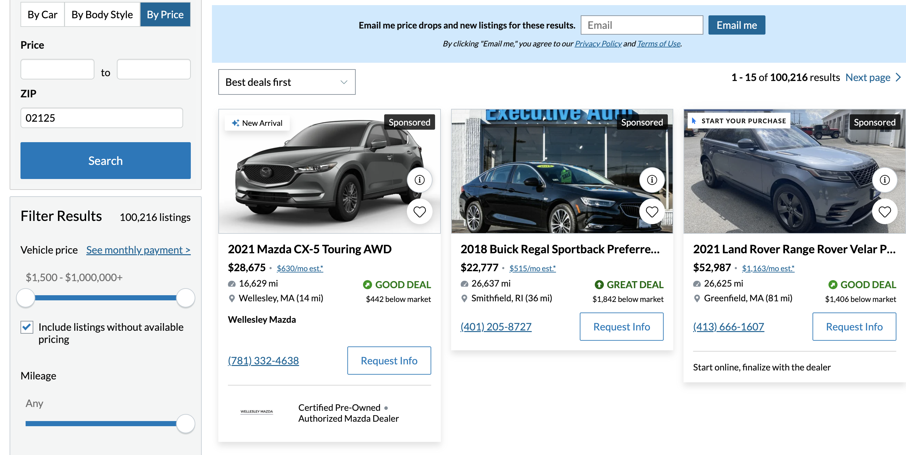
WEB CRAWLING
Car details is available in a block for every car as shown below:

Slide 6
WEB CRAWLING
Used “Webdriver” and “Service” modules under the “Selenium” library
Fields fetched from each block: Brand, Make, Year, MilesDriven, Price, EMI, City, State
Used Chrome developer tool to access the HTML code of the website
Constructed Regex according to the appropriate tags for the data fields using inspect element
Loaded the fetched data into the SQLite database “CarguruFinal.db”
Total rows fetched: 923

Slide 7
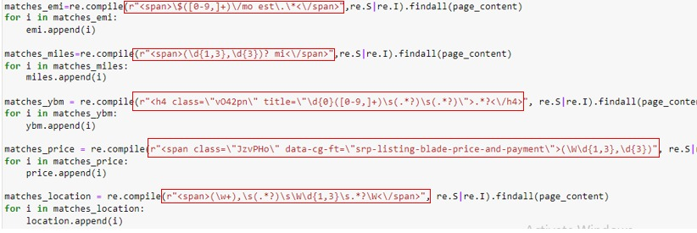
WEB CRAWLER Regex

Slide 8
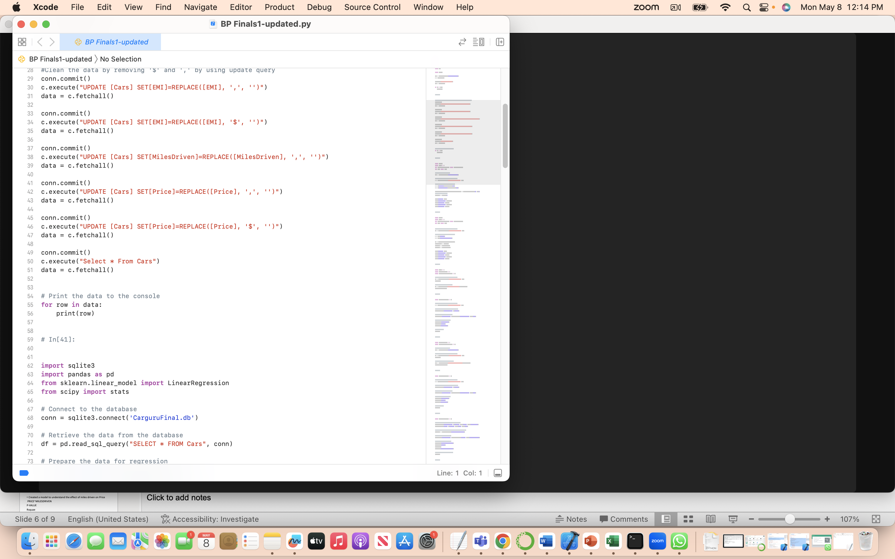
DATA CLEANING
Removed ‘$’,‘,’ to perform calculations.
Apart from this, data fetched was clean with no NULL values

Slide 9

REGRESSION ANALYSIS

Slide 10
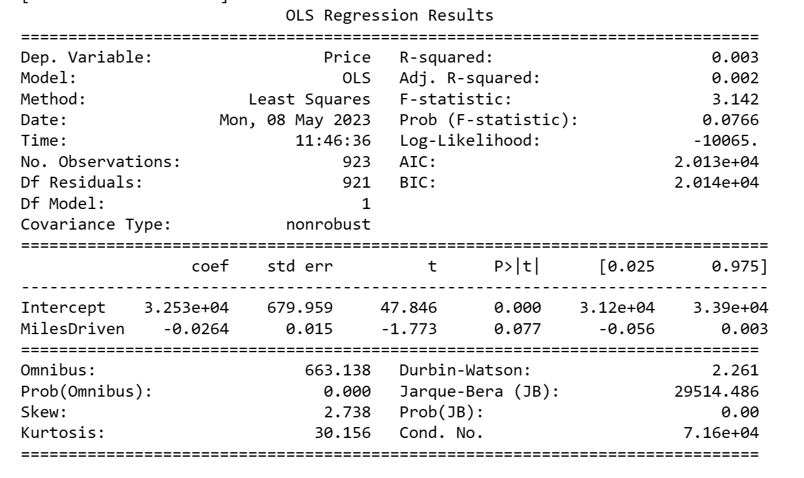
LINEAR REGRESSION
Perform linear regression analysis to model the relationship between the price of cars and miles driven and understand the effect of miles on price.

Slide 11
LINEAR REGRESSION
The MilesDriven coefficient is -0.03 which means one-unit increase in MilesDriven is associated with a 0.0264 decrease in the average price of the car.
Negative Coefficient of miles driven means as the miles increases, the price tends to decrease.
P-value 0.077 is greater than 0.05, indicating that this coefficient is not statistically significant at the 5% level.
It an be seen that the model shows an R square of 0.003 which means that other factors apart from Miles Driven are also affecting the price.
Miles Driven is NOT affecting the Price majorly
Omitted Variable bias exists i.e this statistical model fails to include one or more relevant variables
Hence, we add more factors to the model in next step – multiple regression

Slide 12
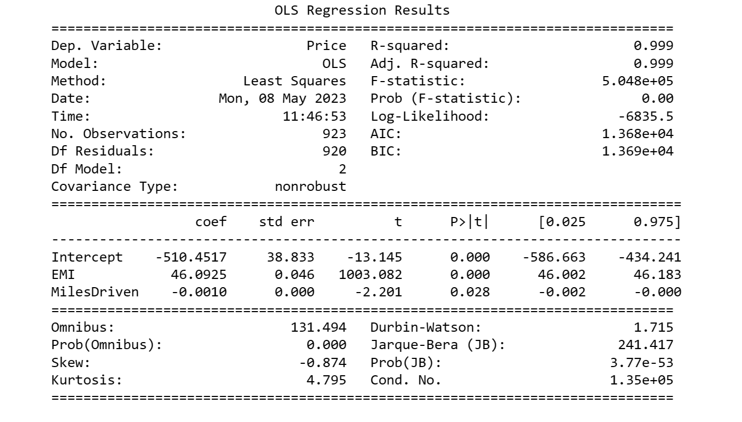
MULTIPLE REGRESSION
Perform multiple regression analysis to model the relationship between the price of cars and miles driven + EMI

Slide 13
MULTIPLE REGRESSION
The MilesDriven coefficient is -0.001. This means that, holding EMI constant, a one-unit increase in MilesDriven is associated with a 0.001 decrease in the average price of the car.
Negative Coefficient for miles driven still holds. As the miles increases, the price tends to decrease.
Similarly, EMI coefficient is 46.09 which indicates that holding MilesDriven constant, a one-unit increase in EMI is associated with a 46.09 increase in the average price of the car.
P-values for both coefficients and the model is close to 0.00 which indicates it is a relevant model.
R square changes significantly from 0.003 to 0.99 indicating that omitted variable bias is removed.
Hence, it can be said that EMI & Miles driven together constitute for a major portion of price and that this model is significant.

Slide 14

VISUALIZATION

Slide 15
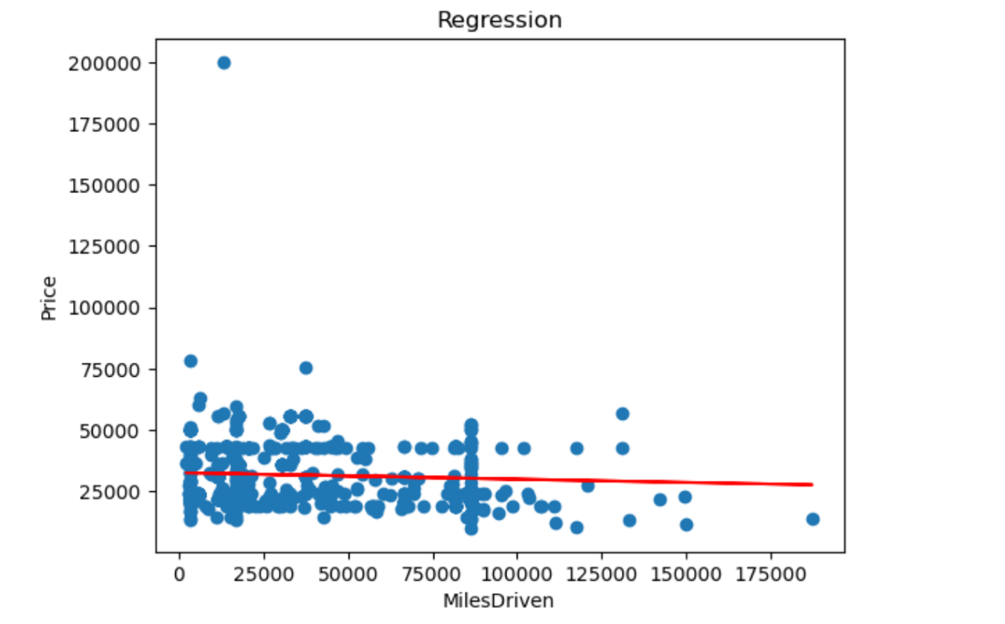
LINEAR REGRESSION PLOT

Slide 16
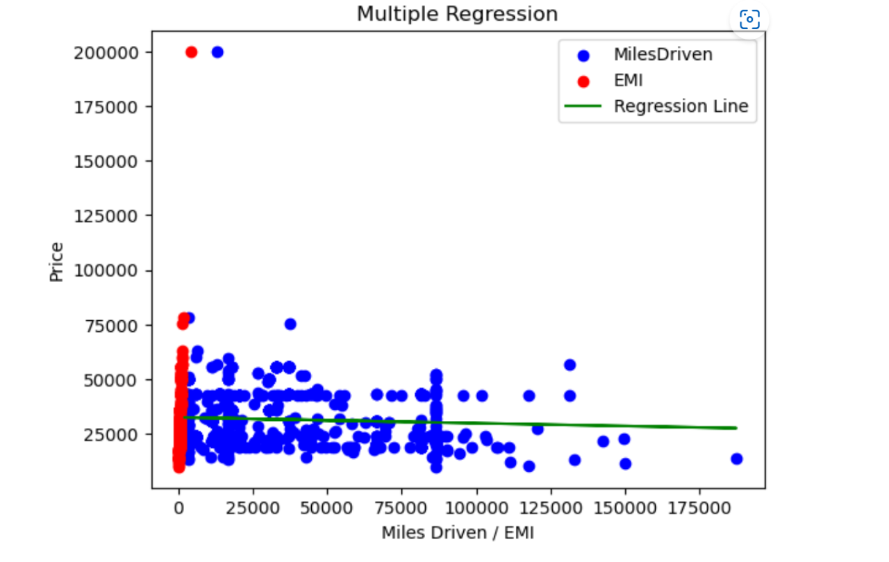
MULTIPLE REGRESSION PLOT
Regression line is going slightly downwards which indicates that with increase in miles, price drops. Also, only two outliers exist at the top left of the graph which can be ignored.
We can also see that the residuals seem to lie closer to the regression line which shows that the model is able to efficiently generalize the trend in data

Slide 17
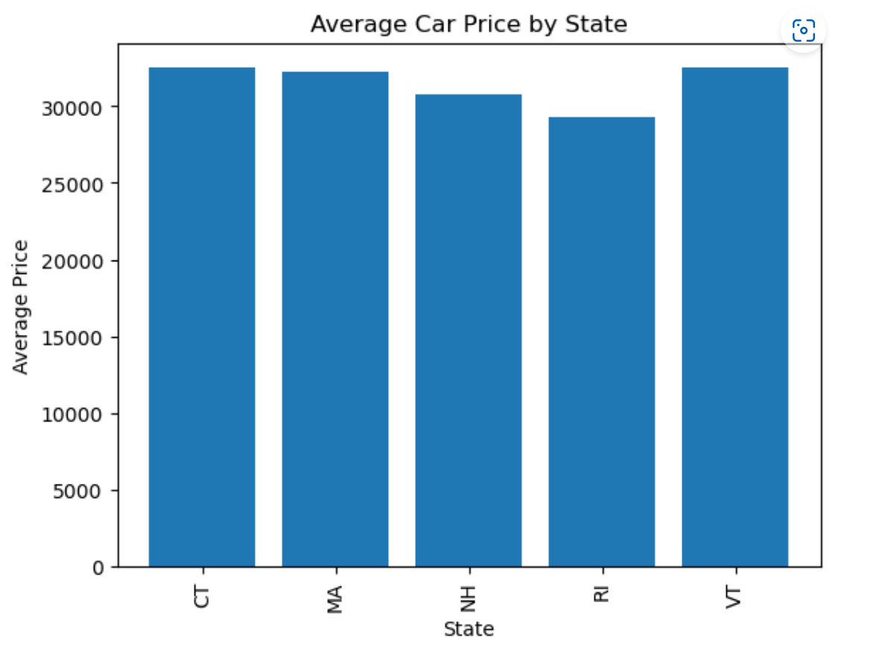
AVERAGE PRICE VS STATE
State can also affect the prices based on tax-laws, maintenance and weather conditions. Average price looks lower for state Rhode Island (RI) and highest for Vermont (VT).

Slide 18
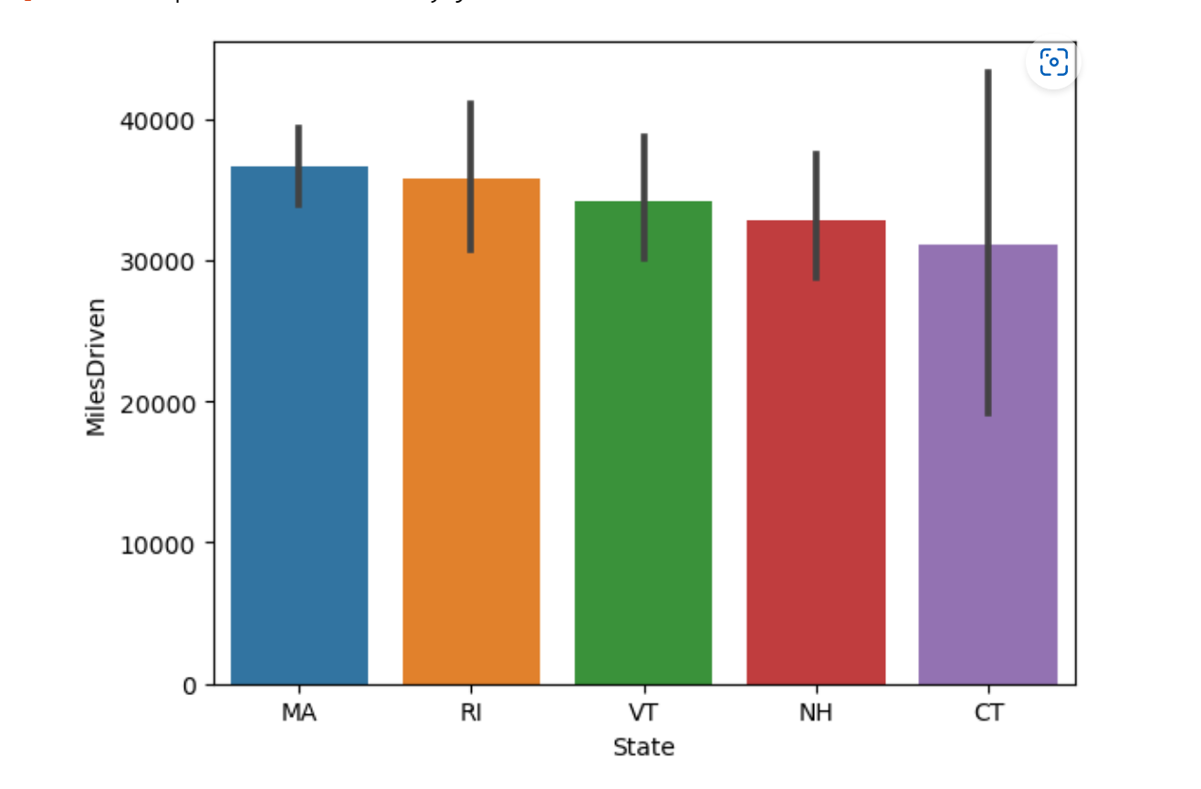
MILESDRIVEN VS STATE
Connecticut ( CT) has the lowest Miles Driven cars available for sales whereas Massachusetts(MA) has the highest.

Slide 19
CONCLUSION WITH EXAMPLES
From bar graph (2) we can see that Rhode Island is amongst the highest Miles Driven state.
As per the regression results – Increase in miles will decrease the average price of cars which means on an average the used cars in Rhode Island are cheaper than the other states.
It can be seen from bar graph(1) our Regression results are in line with what we can see in the bar graph with Rhode Island being the state with least Average Price.
The same applies to other states also.
Also, from the visualization we can see that on an average used cars in MA are more expensive than the other states.

Slide 20
DESCRIPTIVE ANALYSIS

Slide 21
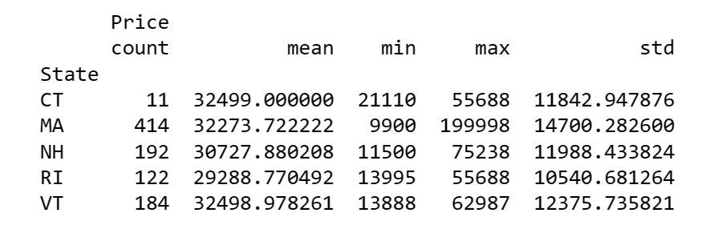
STATISTICAL ANALYSIS BY STATE
Mean price of Rhode Island is the lowest.
Standard Deviation varies widely around the mean.
Both minimum and maximum priced car is available in MA. It also has maximum count of used cars. We can say that MA dominates the market as compared to other states.

Slide 22
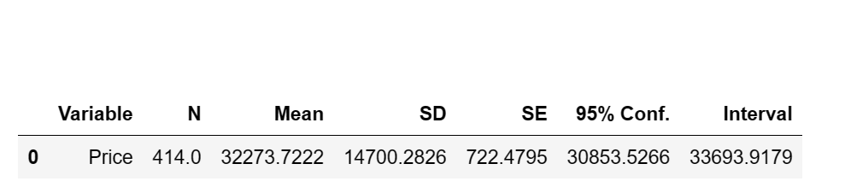
“MA” STATE ANALYSIS
N: There are 414 observations in the dataset.
Mean: The average price of cars in the dataset is $32,273.72.
SD: The standard deviation of the prices in the dataset is $14,700.28. This means that the prices of cars in the dataset vary widely around the mean.
SE: The standard error of the mean is $722.48. This is the standard deviation of the sampling distribution of the mean, which indicates how much the sample mean varies from the population mean.
95% Conf. Interval: The 95% confidence interval for the mean price is ($30,853.53, $33,693.92). This means that we can be 95% confident that the true population mean price lies within this interval.

Slide 23
KEY HIGHLIGHTS
MA dominates the market as compared to other states.
Used cars in MA are more expensive than the other states.
Model with dependent variables EMI & Miles driven together constitute for a major portion of price and that this model is significant.
Negative Coefficient of miles driven indicates that increase in miles decreases the average price of cars.
Rhode Island is amongst the highest Miles Driven state, Hence it is the state with least Average Price.

Slide 24
LIBRARIES AND PACKAGES
import pandas as pd
from sklearn.linear_model import LinearRegression
from scipy import stats
import statsmodels.api as sm
import statsmodels.formula.api as smf
import matplotlib.pyplot as plt
import seaborn as sns
import researchpy as rp
import statistics

Slide 25

ThankYou

